Slide 1
Nevada Water Operator Exam Summaries 3rd Quarter 2022
Bradley Crowell
Director
NDEP Bureau of Safe Drinking Water
Operator Certification Program
Greg Lovato
Administrator
Jennifer Carr
Deputy Administrator
Jeffrey Kinder
Deputy Administrator
Rick Perdomo
Deputy Administrator

Slide 2
2022 3rd Quarter - Distribution
Third Quarter 2022 Summary of Distribution OpCert Exams
Distribution | Date | Test | Total | Pass | Fail | % Pass | Low Grade | High Grade | Median | Most Missed
1 | Q3 | Agg | 8 | 5 | 3 | 63% | 63 | 88 | 74.5 | System Components/Disinfection
2 | Q3 | Agg | 4 | 3 | 1 | 75% | 66 | 85 | 79.5 | Disinfection/SSA & Public
3 | Q3 | Agg | 3 | 1 | 2 | 33% | 47 | 82 | 48 | Disinfection MEA & Lab/Equipment IOM
4 | Q3 | Agg | 3 | 1 | 2 | 33% | 52 | 70 | 69 | Disinfection MEA & Lab
 |  |  | 18 | 10 | 8 | 55%
DISTRIBUTION CATEGORIES:
System Information & Components
Equipment; Install, Operate and Maintain
Monitor, Evaluate & Adjust Disinfection & Lab
Security, Safety, Public Interaction & Administrative Procedures

Slide 3
2022 3rd Quarter - Treatment
Third Quarter 2022 Summary of Treatment OpCert Exams
Treatment | Date | Test | Total | Pass | Fail | % Pass | Low Grade | High Grade | Median | Most Missed
1 | Q3 | Agg | 4 | 4 | 0 | 100% | 72 | 78 | 75
2 | Q3 | Agg | 4 | 2 | 2 | 50% | 64 | 78 | 67.5 | Laboratory
3 | Q3 | Agg | 0 |  |  | NA
4 | Q3 | Agg | 0 |  |  | NA
 |  |  | 8 | 6 | 2 | 75%
TREATMENT CATEGORIES:
Treatment: Monitor, Evaluate and Adjust
Laboratory Analysis
Operate and Maintain Equipment
Evaluate Characteristics of Source Water
Perform Security, Safety & Administrative Procedures

Slide 4
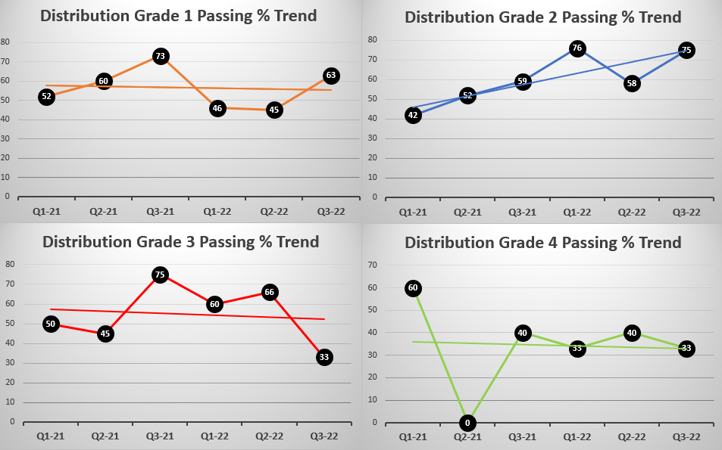
Passing Percentage Trend 2021-2022

Slide 5
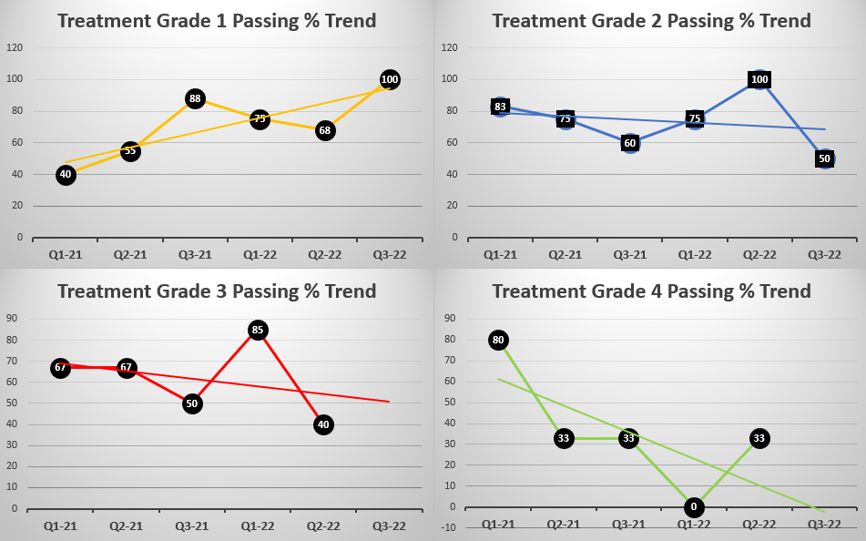
Passing Percentage Trend 2021-2022

Slide 6
NDEP Bureau of Safe Drinking Water
Operator Certification Program
Bradley Crowell
Director
Bureau Chief Andrea Seifert, P.E.
Data Mngmnt / OpCert Supervisor Linh Kieu
Program Manager Carlos Quiroz
Administrative Specialist Rachel Weingart
Greg Lovato
Administrator
Jennifer Carr
Deputy Administrator
Jeffrey Kinder
Deputy Administrator
Rick Perdomo
Deputy Administrator

